Slide 1
Unveiling Missed Optimizations in Compilers through Dead Code Elimination
Presenter : Rakesh Das, Mohammad Nuruddin Course Code: CS 7389D Course Instructor: Dr. Tanzima Islam

Slide 2
Outline
Introduction
Problem Statement
Methodology
Experimental Results
Contribution
Conclusion

Slide 3
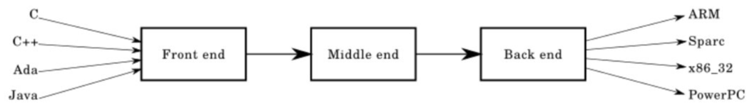
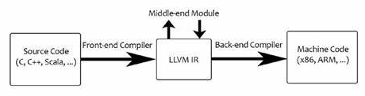
Introduction
Dead Code Elimination: A compiler transformation that removes unreachable instructions or reachable ones whose results are unused. Such code fragments are referred as "dead".
Compiler: Specialized software tool that translates high-level programming code written in languages like C, C++, Java, or Python into machine code that can be executed by a computer's processor.
Fig 1: Compiler Design
Fig 2: Low Level Virtual Machine (LLVM)
Notes:
Motivation: Limitations of Current Metadata Support: Existing metadata support for HPC N-1 workloads on distributed burst buffers faces significant limitations, particularly in managing metadata for shared files across multiple processes.
Introduction of MetaKV: The paper proposes MetaKV as a solution to address these limitations. MetaKV is a key-value store designed specifically to enhance metadata management performance in scientific applications.
Improving Metadata Handling: MetaKV aims to enhance metadata handling for scientific applications by offering fast write operations, efficient read clustering, and optimized communication patterns for shared file operations.
Scalability and Performance: MetaKV is designed to deliver scalable and high-performance metadata services under various scientific metadata workloads. It aims to provide significant improvements over existing state-of-the-art solutions in terms of scalability, efficiency, and overall performance. Goals: Develop an architecture integrated with both established and newly developed tools to collect and analyze online performance statistics of scientific workflow executions from heterogeneous sources. Enable the correlation of online workflow performance data with data from the underlying infrastructure to optimize system design and solution development. Validate the approach through real-world workflow executions under both normal and anomalous conditions to demonstrate its effectiveness in identifying anomalies. Provide a comprehensive resource of training data for automated machine learning analysis to enhance scientific productivity and infrastructure optimization efforts.
Exascale computing represents a significant advancement in the capability of supercomputers, enabling them to perform a quintillion, or 10^18, calculations per second. This leap in computing power is opening doors for simulations and problem-solving at scales that were previously unattainable, particularly in fields such as materials science and high-performance computing (HPC).
I/O-intensive genome analysis workflow
CPU- and memory-intensive material science workflow.

Slide 4
Introduction (contd.)
GNU Parallel: Command-line utility for Unix-like operating systems that enables parallel execution of shell commands and scripts. It is particularly useful for tasks such as data processing, file manipulation, text processing, batch jobs, and computational tasks that can be parallelized.
Dynamic Load Balancing: technique used in distributed computing systems to evenly distribute computational tasks or workload among multiple processing units, such as CPUs, GPUs, or servers, in real-time. The goal of dynamic load balancing is to optimize resource utilization, minimize processing time, and ensure fairness across the system, even as workload characteristics change dynamically.

Slide 5
Introduction (contd.)
GNU Parallel: Command-line utility for Unix-like operating systems that enables parallel execution of shell commands and scripts. It is particularly useful for tasks such as data processing, file manipulation, text processing, batch jobs, and computational tasks that can be parallelized.
Dynamic Load Balancing: Technique used in distributed computing systems to evenly distribute computational tasks or workload among multiple processing units, such as CPUs, GPUs, or servers, in real-time. The goal of dynamic load balancing is to optimize resource utilization, minimize processing time, and ensure fairness across the system, even as workload characteristics change dynamically.
CSmith: Csmith is a random generator of C programs. It's primary purpose is to find compiler bugs with random programs, using differential testing. git clone https://github.com/csmith-project/csmith.git

Slide 6
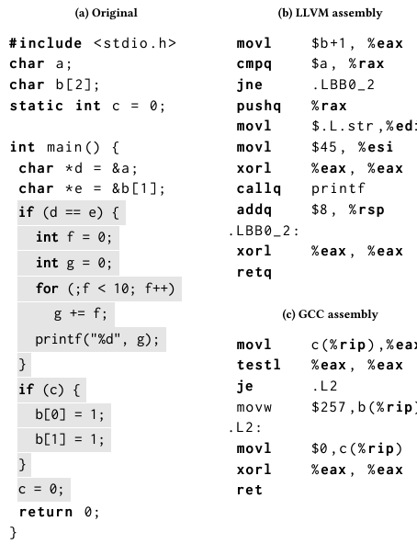
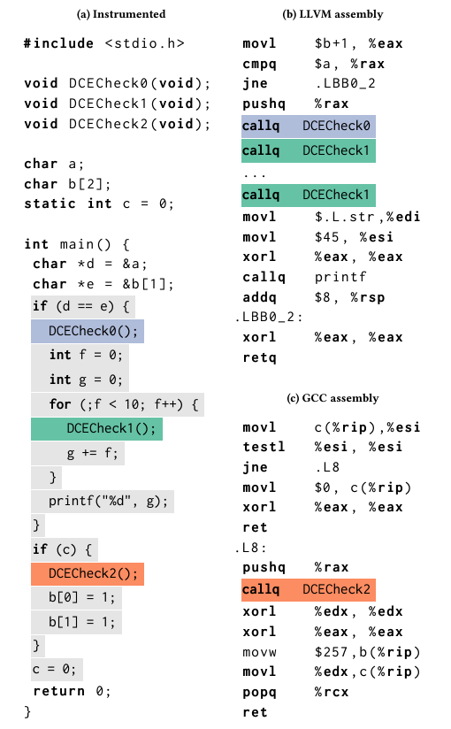
Problem Statement
Identifying missed optimizations in compilers is a significant challenge.
The approach leverages dead code elimination (DCE) to systematically assess compiler optimization effectiveness by strategically inserting "optimization markers".
By evaluating how well compilers eliminate dead code, the work offers a simple yet comprehensive means to identify and address a wide range of missed optimizations in a program.

Slide 7
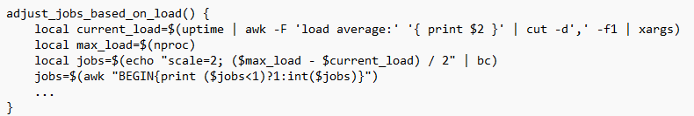
Methodology
Generating and applying markers:
The script uses GNU Parallel to execute multiple instances of the Csmith command, each generating a unique C source file.
For each file generated, the program markers are applied immediately in the same command chain, ensuring that the file is ready for compilation as soon as it is created.
This use of parallelism minimizes waiting times that would occur if each file had to be processed sequentially.
Code Generation with Csmith
Initiation of Marker
Compilation
LLVM
Dynamic Job Adjustment:
The script calculates the number of jobs to run simultaneously based on the current system load. This helps in adapting the workload according to the system's capability at any given moment, avoiding overloading and ensuring smooth execution.
The calculation ensures at least one job is always running while capping the maximum number of jobs to prevent overloading.
GCC
Assembly Generation
Analyzing Assembly
File Generation

Slide 8
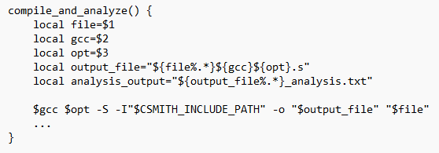
Methodology
Compiling and analyzing:
Each generated file is compiled with different GCC compilers and optimization flags.
The compilation outputs are .s assembly files, which are then searched for specific markers (DCEMarker).
The count of these markers is recorded, providing a metric for analysis.
Experimental Setup:
The experiments were conducted on a desktop equipped with a 13th Gen Intel(R) Core(TM) i7-13700 processor. The system features a single socket with 16 cores and supports hyper-threading, providing a total of 24 logical CPUs. The processor operates with a base frequency of 800 MHz and can boost up to 5200 MHz. The desktop has 31 GB of RAM and utilizes 7.5 GB of swap space. For virtualization, Intel's VT-x technology is available. The system runs on an x86_64 architecture under a little-endian configuration.

Slide 9
Methodology
Number of Programs 200, 500, 1000, 2000, 5000 Versions: GCC: 9, 10, 11, 12 LLVM: 11, 12, 13, 14 Flags: -O0: No optimization. Debugging mode, generates unoptimized code.
-O1: Moderate optimization. Enables most optimizations that do not involve a space-speed tradeoff.
-O2: More aggressive optimization. Enables further optimizations that may increase compile time and code size.
-O3: High optimization level. Includes more aggressive optimizations such as inlining and loop unrolling.
-Os: Optimize for size. Attempts to reduce the size of the generated code, sacrificing some speed.

Slide 10
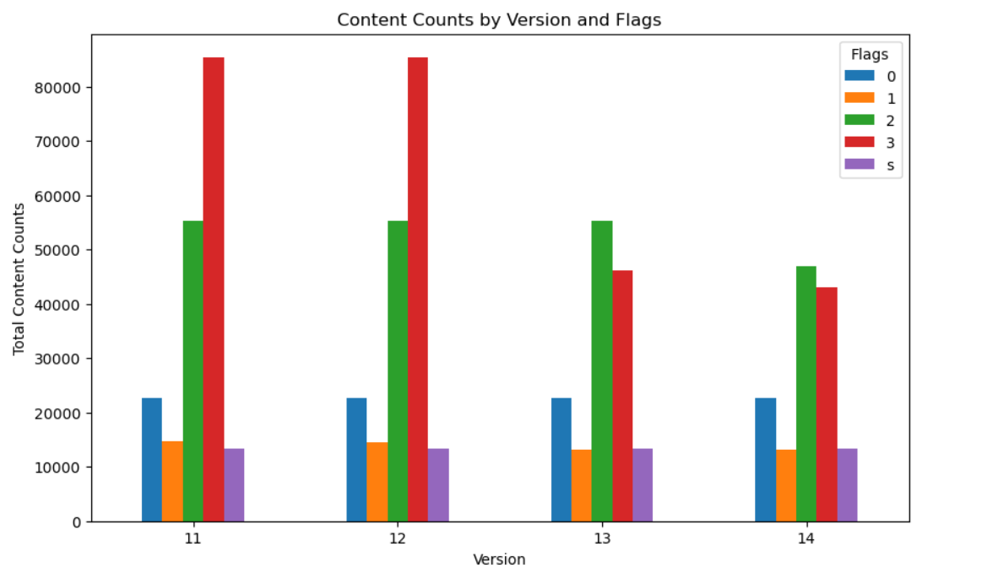
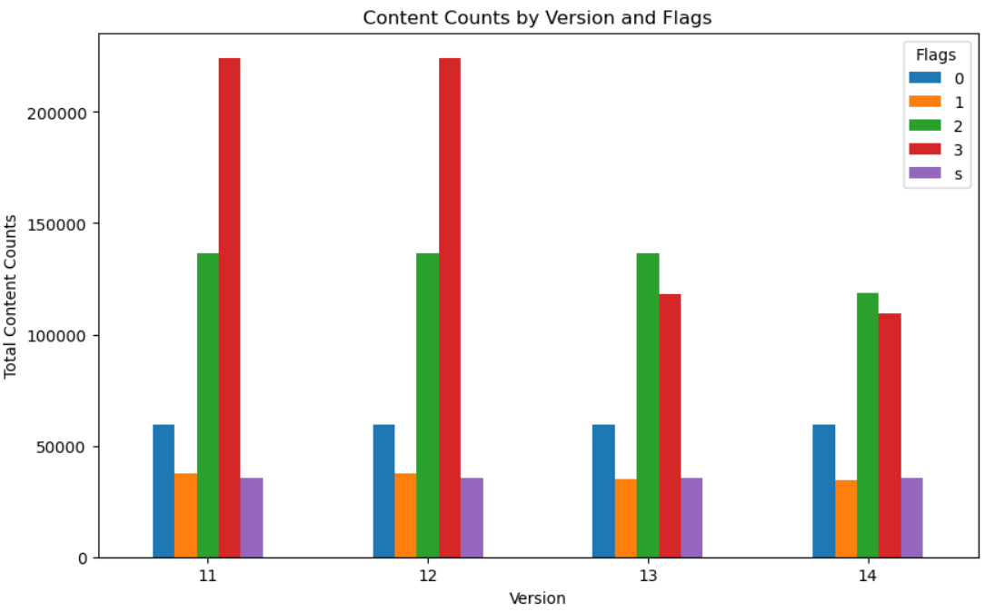
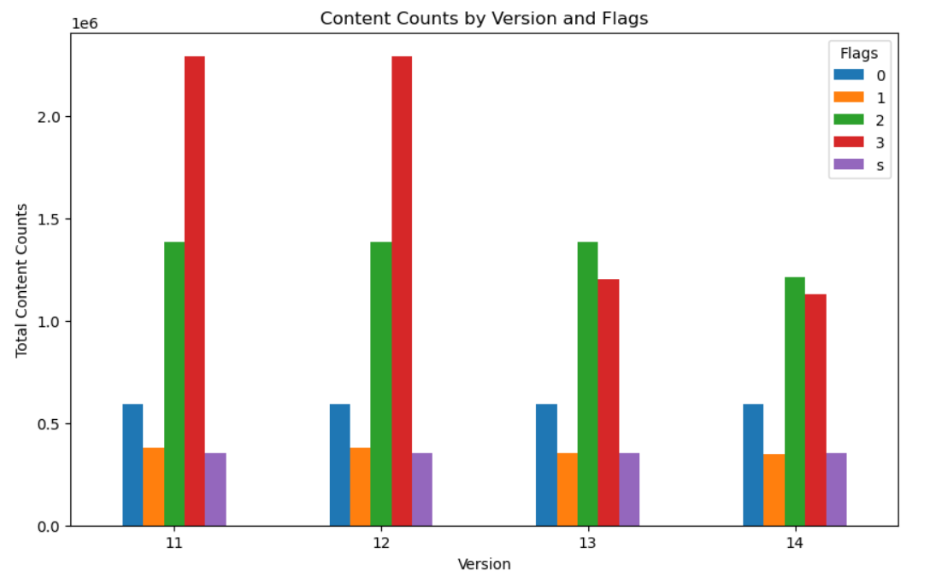
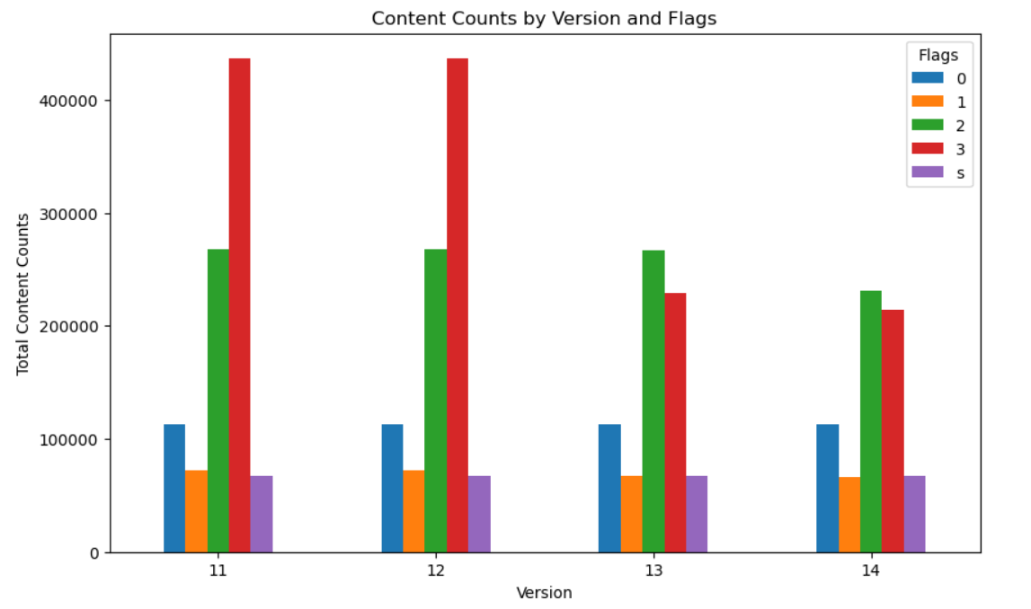

Experimental Results
500
200
5000
1000
LLVM with Optimization
2000

Slide 11
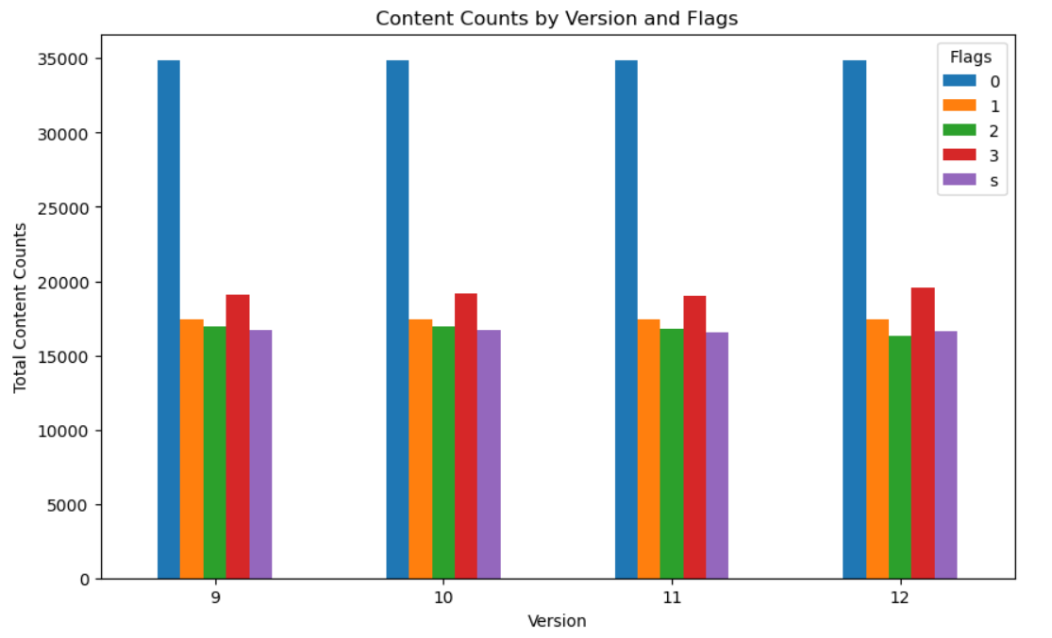
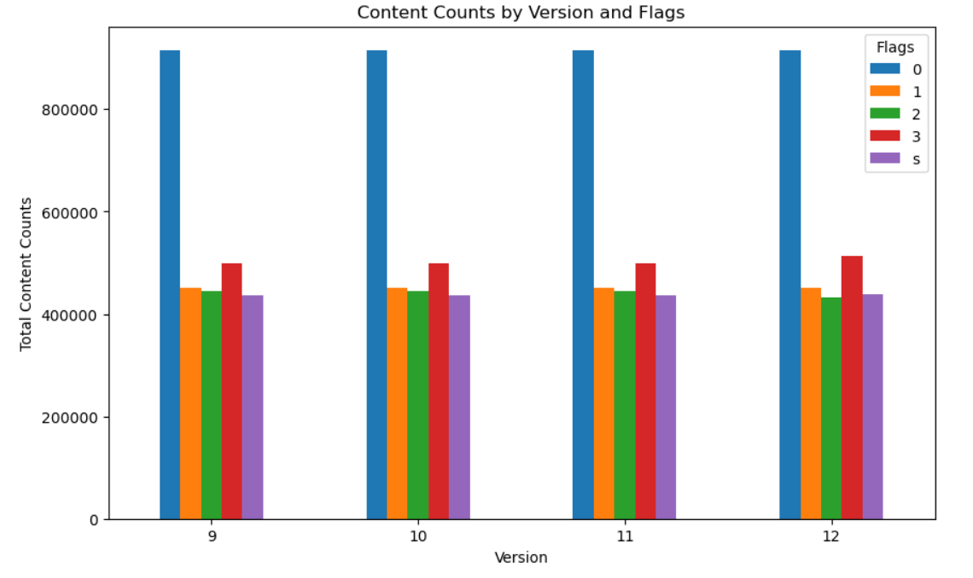
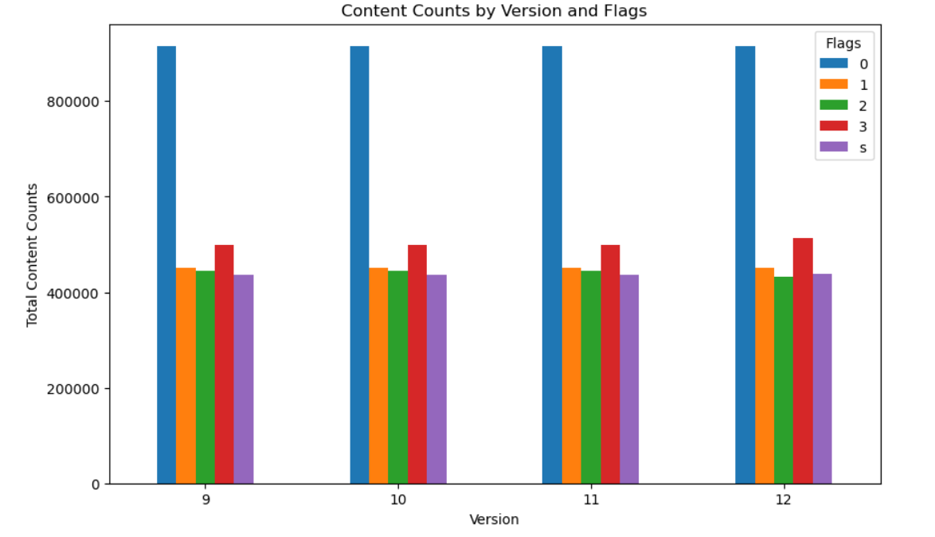
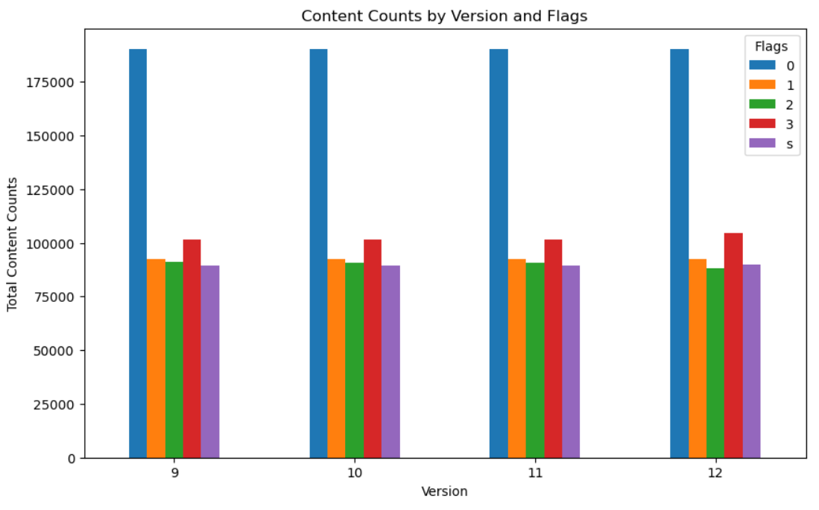
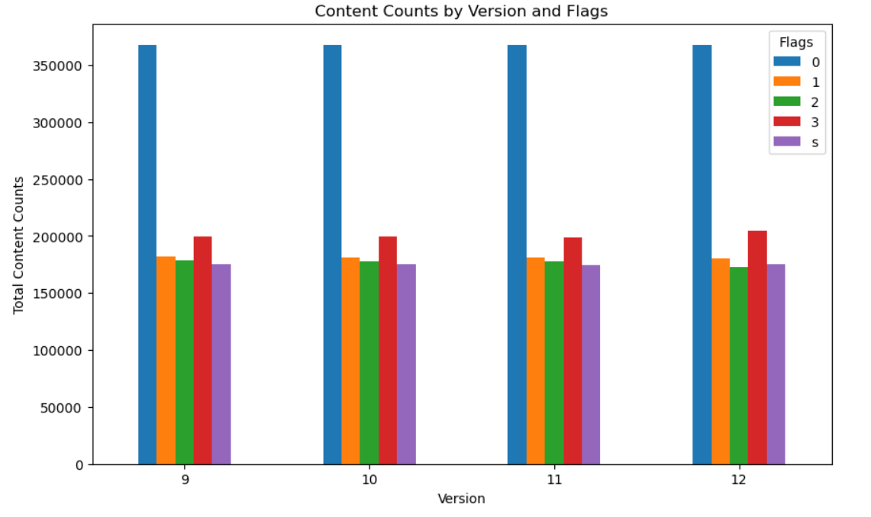
Experimental Results
500
200
5000
GCC with Optimization
1000
2000

Slide 12
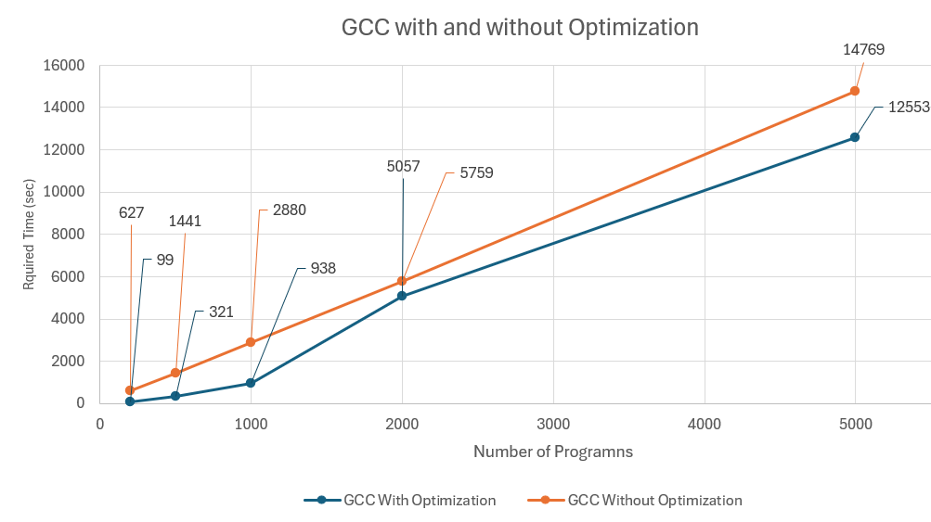
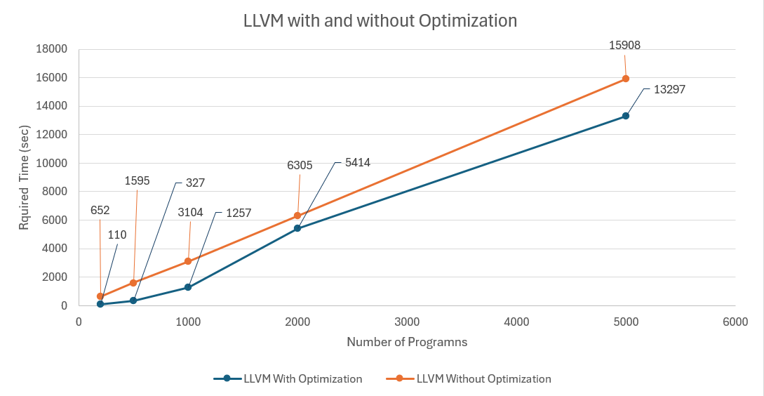
Experimental Results

Slide 13
Contribution
Efficiency and Speed: By running tasks in parallel and adjusting to system load, the script minimizes idle CPU time and finishes tasks faster than sequential execution.
Scalability: The approach scales seamlessly with additional CPU cores or changes in system configuration, making it robust across different environments.
Resource Management: Dynamic load balancing helps in utilizing system resources effectively without overwhelming the system, thus maintaining stability and performance.
Notes:
Integrated Architecture for Data Capture and Analysis: The paper presents an architecture that integrates existing tools with newly developed ones to collect and analyze performance data from scientific workflows. This approach aims to improve the design, development, and optimization of next-generation systems and solutions by capturing workflow characteristics and performance data in real-time.
Combining Panorama and RAMSES Strengths: By leveraging the strengths of both the Panorama and RAMSES projects, the architecture aims to offer a comprehensive system for capturing workflow and infrastructure performance data, enhancing the understanding of scientific workflows in extreme-scale science environments.
Real-World Workflow Execution Validation: The approach was validated using two real-world scientific workflows under normal and anomalous conditions. This included an I/O-intensive genome analysis workflow and a CPU- and memory-intensive material science workflow, demonstrating the system's ability to correctly identify injected anomalies.
Automated Data Collection and Analysis: The system automates the process of gathering, storing, and analyzing large volumes of heterogeneous data, leveraging the ELK stack (Elasticsearch, Logstash, and Kibana) for efficient data ingestion, discovery, retrieval, and visualization.
Enhancing Scientific Productivity: The architecture is designed not only to improve application performance through better understanding and optimization but also to aid in the development of novel, application-aware schedulers for workflow systems and anomaly detection during workflow executions.
Comprehensive Knowledge Base Creation: Through the orchestration of well-established tools, the proposed system facilitates the creation of a comprehensive knowledge base of applications, system characteristics, and requirements. This helps address the complexity of scientific applications and the nature of distributed computing by providing a broader understanding of system behavior and environment.

Slide 14
Conclusion
The process involves breaking down a task that can be executed concurrently into multiple smaller tasks and then executing those tasks simultaneously across multiple processors. This concept refers to the system's ability to monitor and distribute workload dynamically across different processors based on their current load. The goal is to optimize resource utilization, avoid overloading any single processor, and reduce the overall execution time.
Notes:
Integrated Architecture for Data Capture and Analysis: The paper presents an architecture that integrates existing tools with newly developed ones to collect and analyze performance data from scientific workflows. This approach aims to improve the design, development, and optimization of next-generation systems and solutions by capturing workflow characteristics and performance data in real-time.
Combining Panorama and RAMSES Strengths: By leveraging the strengths of both the Panorama and RAMSES projects, the architecture aims to offer a comprehensive system for capturing workflow and infrastructure performance data, enhancing the understanding of scientific workflows in extreme-scale science environments.
Real-World Workflow Execution Validation: The approach was validated using two real-world scientific workflows under normal and anomalous conditions. This included an I/O-intensive genome analysis workflow and a CPU- and memory-intensive material science workflow, demonstrating the system's ability to correctly identify injected anomalies.
Automated Data Collection and Analysis: The system automates the process of gathering, storing, and analyzing large volumes of heterogeneous data, leveraging the ELK stack (Elasticsearch, Logstash, and Kibana) for efficient data ingestion, discovery, retrieval, and visualization.
Enhancing Scientific Productivity: The architecture is designed not only to improve application performance through better understanding and optimization but also to aid in the development of novel, application-
1
aware schedulers for workflow systems and anomaly detection during workflow executions.
Comprehensive Knowledge Base Creation: Through the orchestration of well-established tools, the proposed system facilitates the creation of a comprehensive knowledge base of applications, system characteristics, and requirements. This helps address the complexity of scientific applications and the nature of distributed computing by providing a broader understanding of system behavior and environment.

